Slide 1

UNIX Training
An overview of PAREXEL’s SAS UNIX Platform

Slide 2
Objectives
How to request access to PAREXEL's SAS UNIX platform
How to logon to PAREXEL's SAS UNIX platform
How to use PAREXEL's SAS UNIX platform
Allow users to be more efficient when using UNIX
Understand the file system and navigation in the UNIX environment
Understand how to edit files
Understand system usage
Understand how to resolve issues
Awareness of UNIX software
Notes:
To enable the users clarity on the UNIX commands, all commands will be highlighted in red font to ensure they are easy to locate.

Slide 3

Pre-requisites and logging in
Part One: Before we begin
3
3

Slide 4
Before we begin: What is UNIX?
4
UNIX is a computer operating system (OS).
HP-UX differs from the Windows OS by being text based and not graphics based.
Notes:
4

Slide 5
Before we begin: Prerequisites
5
To use UNIX at PAREXEL, you must meet the following requirements
Complete this training
Have a UNIX account
Have Citrix desktop set-up
Have WinSCP client installed
All the above can be obtained by using the Service Desk, CAPS and LMS
Navigate to the PAREXEL Connect Site http://ep.pxl.int/portal/server.pt
In the “My Hot Links” box, select either “CAPS” or “Service Desk” http://service.pxl.int/
Notes:
5
Demo: navigate to CAPS via PXL Connect

Slide 6
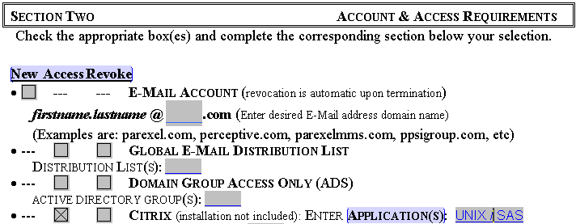
Before we begin: Citrix set-up
Users should have Citrix accounts requested by their manager when they start at PAREXEL.
However, if required, a global access request form may be completed with this request.
Next to the CITRIX line, click the access box and in the text box type in UNIX / SAS
The form should then be signed by your line manager or an appropriate person as detailed on the top of the form
6
Notes:
6
IT Home page
IT forms
Path of this document
http://ptprodcontent:7087/publishedcontent/publish/parexel_connect/inview/articles/archive/2009_01_08_caps.html

Slide 7
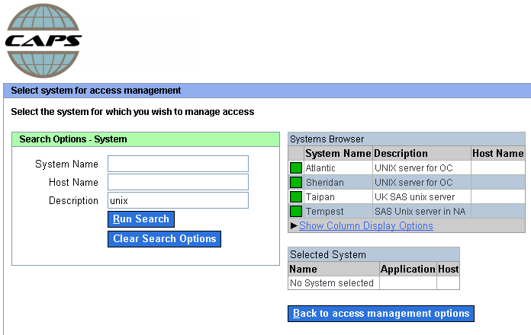
Before we begin: Requesting a UNIX account
To request a UNIX account – you need to submit a CAPS request
A prerequisite of this is the users should be trained in the CAPS system
7
Notes:
7
Demo: requesting a unix account
CAPS request – add “unix” to the description field before searching

Slide 8
Before we begin: WinSCP client set-up
8
WinSCP is a free SFTP (Secure Shell File Transfer Protocol) client for windows. It’s main function is to allow safe copying of files between a local and remote computer (e.g. the transfer of files from your local machine to a UNIX directory)
sFTP is used rather than FTP as it is more secure and uses encrypted methodology
WinSCP can be installed via the Novell-delivered Applications window by selecting the icon and double clicking on it
If the icon is not available, alternatively a service desk request may be submitted requesting WinSCP to be installed on your computer
The minimum required version of WinSCP is 4.1.8
Notes:
8

Slide 9

Before we begin: Logging on via Citrix
To access UNIX, the user needs to login via Citrix and use the desktop folders to access the remote desktop where UNIX is installed
Once the desktop is available on screen, the user should double click on the kennet icon to log in to the UNIX server.
9
Notes:
9
Expect the users to have already requested Citrix installation, desktop folders access requested
Demo: logging into unix via Citrix

Slide 10
Project access, navigation, basic commands
Part Two: Now you’re logged on
10
10

Slide 11
Now you’re logged on: Citrix, Exceed and unix
11
Citrix is used to remotely connect to another PC, the remote desktop contains a link to the unix instance
Exceed is a PC program which supplies window management services for unix applications. As Windows is incompatable with unix systems, therefore Exceed needs to be used.
Exceed will begin upon clicking on the unix shortcut.
Whereas windows is mainly graphically driven, unix is a command line interface.
Notes:
11

Slide 12
Now you’re logged on: Naming conventions
12
UNIX is case sensitive so will differentiate between the files test.sas and TEST.SAS as different files.
File names can be up to 256 characters long
Avoid using special characters in file names such as
| ; , ! @ # $ ( ) < > / \ " ' ` ~ { } [ ] = + & ^ <space> <tab>
Instead of spaces in file names and directory names, use characters such as _ - . (underscore, subtraction or period)
Notes:
12
Having spaces in filenames can make it difficult to navigate / view the files in UNIX.
Samba – i.e. pdf files ok, but people tend to use spaces in Samba without thinking of the impact on UNIX
Having spaces in directory names will make it difficult to navigate to those directories

Slide 13
Now you’re logged on: UNIX manual
13
The man command in UNIX provides an on-line system manual on providing information which can be used to
To display details about the listing (ls) command, use man ls
Pressing enter moves through the on-line manual line by line
Pressing space moves through the on-line manual page by page
To search for a keyword passwd in the manual, use man –k passwd
To return a specific section (say section 1 on the passwd command), use man 1 passwd
Notes:
13
Examples for
Man ls – manual for list (ls)
Man mkdir – manual for creating directory
Man passwd – manual for changing passwd
Man cp – manual for copying files
Man –k passwd – search for a wrk e.g. passwd
Man –f passwd – checking the files available for keyword “passwd”
Man 1 passwd – elaborating the above command (1) is for a specific section
List all manual entries whose one-line description contains any of a specified set of keywords.
Display or print one-line descriptions of entries specified by name.
Search on-line manual directories by entry name and display or print the specified entry or entries.
Search a specified on-line manual section (directory) and display or print the specified entry or entries in that section.

Slide 14
Now you’re logged on: Changing your password
14
UNIX account passwords expire every 90 days
So it is important that you are able to change your password. When the password expires, the system will prompt you for a new password at logon.
If you wish to change your password at any time manually, then the steps below should be followed
At the UNIX prompt, type passwd
The system will ask for your old password, type this and press return
If successful, the system will then ask for your new password, again type this and press return
The system will then ask for your new password again to confirm the change, type your new password and press return
The system will display “Passwd successfully changed”
Your UNIX passwords are not linked to your smartcard so must be entered each time the user logs in.
Notes:
14

Slide 15
Now you’re logged on: Password rules
15
A password must follow the following rules to be allowed:
Must be at least 8 characters in length
Must be alphanumeric characters and numbers
Must differ from the users name
e.g. aardvar6 would be a valid password
aardvark would be an invalid password
aard5 would be an invalid password
A new password must differ from the old one by at least three characters
Can’t use a previous password from the last 10 passwords used in the history, e.g. your password from 2 times before can not be reused
Notes:
15

Slide 16
Now you’re logged on: Listing project access
16
For each project area on UNIX, access is restricted to those users with authorised access
You can list which projects you have access to by typing studies
By typing studies {username} you can check access for other users
For example typing studies cantrea will list all the projects that the user cantrea has access to
ls /projects can be used to list all projects on the system
Notes:
16
Examples
Studies
Ls /projects

Slide 17
Now you’re logged on: The project area
17
To navigate to a project area, type the project name at the prompt, e.g. pxl97971 and press return
You will now be at the following location /projects/pxl97971/dm (for dm users) or /projects/pxl97971/stats (for stats users)
Within each project directory, there are 3 top level folders
dm
stats
transfer
The dm folder is accessible by all project staff in the dm group
The stats folder is accessible by all project staff in the stats group
The transfer folder is accessible by all project staff and can be used to transfer files between the dm and stats groups
Notes:
17
Transfer folder should be used as a temporary holding area for transferring data between “dm” and “stats” groups on a project
Demonstrate on how to navigate to a project area – esbat91759
Demonstrate how to navigate to stats and transfer area

Slide 18
Now you’re logged on: Navigation
18
To navigate to an existing folder (export), type cd (change directory) followed by the folder name,
e.g. cd export
The prompt will change from /projects/pxl97971/dm to /projects/pxl97971/dm/export which demonstrates that the user has navigated to the export folder
By typing cd .. you can navigate up one level in the directory you are in, by typing this when in the direct /projects/pxl97971/dm/export, it will change the folder to /projects/pxl97971/dm
Notes:
18

Slide 19
Now you’re logged on: Navigation
19
Additionally typing cd the user will be taken to their home area, e.g. /home/users/cantrea
To navigate up multiple levels at once, use cd ../../transfer this would navigate up 2 directory levels, then change into the transfer directory
Notes:
19
Demonstrate on how to navigate multiple levels at once
$Projects/esbat91759/dm/export cd ../../transfer

Slide 20
Now you’re logged on: Navigation in unblinded area
20
To create a new project on UNIX, a request must be submitted using a global new project request form which should be attached to a service desk ticket
The /projects (blinded), /unblinded and /randomisation areas are created up front when a new UNIX project is set-up however access is only granted through CAPS.
The /unblinded area is used for storing programs and data related to activities that refer to data that should not be viewed by blinded programmers
The /randomisation area is used for the generation of randomization codes
Notes:
20
It is the responsibility of the DOL to fill this form - Show the Global New Project Request Form
http://ptprodcontent:7087/publishedcontent/publish/dataoperations/usefullinks/links/global_new_project_request_form.html

Slide 21
Now you’re logged on: Listing files
21
The ls command lists the files and directories in a directory
By adding additional options to this command, the output can be tailored
ls –l or ll will display a long list of the files and directories
ls –al will display a long list of all files including hidden files
ls – trl will display a long list in reverse date order, newest at the bottom
ls –Rl will display a recursive list of the files and directories
Note: As UNIX is case sensitive, it is important to use R instead of r
ls –sl will display a long list with 512 byte blocks listed in the left hand column
Notes:
21
L, ll is for the list of all files
Al – list of all files including hidden files
Trl – newest at the bottom
Rl – recursive list of all the files within each directory
Sl – displays the list of files with the number of bytes blocks listed on the left side
The disk is divided into 512 byte blocks. Depending on the size of the file how many byte block are occupied by the files is given in the left hand column

Slide 22
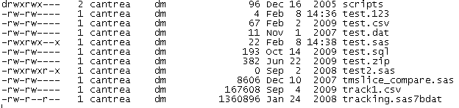
Now you’re logged on: Listing files
When using ls -l to list the files, the following columns will be displayed
File (-) or directory (d)
User permission
Group permission
Others permission
File owner
Group owner
File size
Modification date and time
File name
22
Notes:
22
[Add arrows to picture]
Filesizes are in bytes
In general the OTHER group should not be granted any access to files / folders
Rw – read wirte permission
Rwx – read write execute permission on the file
9 – first 3 spaces for the user permission on the file --- (rwx) if x is missing then assume there is no execute permission on the file.
Next 3 for the group permission e.g. dm
Next 3 for others permission other groups or other users.

Slide 23
Now you’re logged on: File permissions 1
Read
Write
Execute
Level 1 - Owner
Read
Write
Execute
Level 2 - Group
Read
Write
Execute
Level - 3 Other

Slide 24
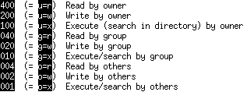
Now you’re logged on: File permissions 2
The chown command can be used to change the owner of a file, to change the owner of a file (test4.txt) from smithj to doej, use chown doej test4.txt
Only the owner can change ownership or permissions of a file
The chmod command changes the permissions of a file according to the parameters specified.
Only the owner of a file or with appropriate privileges can change its mode.
There are three levels of file permissions (owner, group and others).
The “others” permission should generally have no access
Within each level, the permissions can be set as read access, write access and execute access (the typical permission granted is 770 – owner and group / read, write & execute)
24
Notes:
24
You can change the ownership of a file only if you are the owner of the file.
e.g. home directory change a file conmed.sas7bdat from ushashs to danabol

Slide 25
Now you’re logged on: File permissions 3
To deny write permissions to others on a file (export.sas), use chmod 775 export.sas
To make a file (listing.sas) executable by all, use chmod 777 listing.sas
To assign read, write,execute access to the owner and read and execute access to group (run.sas), use chmod 770 run.sas
At PAREXEL, the general rule should not be granting project directories / files to the others group
25
Notes:
25
Chmod o-w [chmod 775]
Chmod a+x [chmod 777]
Chmod u+rw go=r [chmod 755]

Slide 26
Now you’re logged on: File permissions 4
The chgrp command can be used to change the group that has access to a file or directory. To change the group that can access a file (test5.txt) from dm to stats, use chgrp stats test5.txt
To recursively change the privileges, owner or group values, can specify the –R suffix
To provide 770 access to all files in a directory (export), use the command chmod –R 770 export/
26
Notes:
26
Demonstrate
Chmod 777 cm.sas7bdat
Chgrp stats cm.sas7bdat
Mkdir abc
Touch a b c d e f
Chgrp dm to stats
Chgrp –R stats abc

Slide 27
Now you’re logged on: Searching for files
27
The find command searches through a directory structure searching for files that match the required criteria.
To find a file (test.sas) in the current directory and all directories below the current directory use find . –name test.sas
To find any file in the current directory and all directories below the current directory that contains the string oak use find . –name “*oak*”
To find all sas programs in a project, use
find /projects/{project name}/dm –name “*.sas”
Notes:
27
/ “slash” means it searches from root directory
(don’t use /)
. “dot” means it searches from the current directory where you are located
e.g. find . –name pgm.asv
If you want in any specific directory ./directory name
e.g. find ./test –name a
find . –name test.sas
find . –name “*oak*”
find /projects/{project name}/dm –name “*.sas”

Slide 28
Now you’re logged on: Copying and moving files
The cp command lets you copy a file from one location to another
To copy a file (file1) to another file (file2) use cp file1 file2
To copy a file (test.sas) to a directory (/sasprogs) use cp test.sas ./sasprogs
To copy a file /projects/pxl97971/dm/export.sas to your current directory, use
cp /projects/pxl97971/dm/export.sas . (this dot refers to the current directory)
The mv command lets you move a file from one location to another
The command is similar to the cp command but deletes the initial file
To rename a file (file1) to another file (file2) use mv file1 file2
To move a file (file1) to a directory (/temp) use mv file1 ./temp
To move all files in the directory to the /tmp directory use mv * ../tmp
28
Notes:
28
Example
Note: Make sure before copying any file the file with a same name does not exist otherwise it gets replaced and the contents of the old file will be lost.
e.g. cp abc.log xyz.log (xyz.log already exists)
$ cat abc.log
$ cat xyz.log
Show the changes in file xyz.log the text Unix training will be replaced by Hello PAREXEL.
Copy file A from test directory to test1 directory
$ cp ./test/a ./test1
Another way
Log into the directory test
$ cp a ../test1
Move
When in test directory
$ mv a ../test1 will move file a from dir test to dir test1
$ mv * ../test1 will move all the files from test to test1
$ mv a b c d e f abc.log xyz.log test.zip ../test will move all these files from test1 to test
For moving directories
$ mv test ../test1 will move the directory test into test1
$ cd test1
$ mv test ../ will move back the directory to the required area

Slide 29
Now you’re logged on: Removing and creating files
29
The rm command lets you remove a file
To remove a file (export_test.sas) use rm export_test.sas
The rmdir command lets you remove a directory
To remove an empty directory (temp) use rmdir temp
rm –r –i <directory name> will recursively (in turn) remove all files within a directory and the directory itself and will prompt the user to confirm each deletion
When using the rm and rmdir commands, it is suggested you always use the –i option
The mkdir command lets you create a directory
To create a directory (temp1) use mkdir temp1
Notes:
29
add slide notes about being careful with recursive deletion
Use rm to just delete file
Use rmdir to delete directory
Rm –r will delete the files within the directory
go to training directory
$ rmdir –r –i tran01

Slide 30
Now you’re logged on: Searching within files 1
30
The grep (Global Regular ExPression) command lets you search a file for a specific text string
To search a file (validate.sas) for the text (“program”) use grep program validate.sas
The system will display any occurrences of the text searched for, so if the file contains the text “program” and “programming”, both results will be returned
Note: grep –i does a case insensitive search, so text, TEXT and tEXt will all be found for the word text
Notes:
30
$ grep Hello abc.log will return Hello PAREXEL

Slide 31
Now you’re logged on: Searching within files 2
The head command lets you view the header of a file (by default 10 lines)
To view the first 20 lines of a file (test.txt) use head –n 20 test.txt
The tail command lets you view the tail of a file (by default 10 lines)
To view the last 15 lines of a file (test.txt) use tail –n 15 test.txt
To view a log file (export.log) that is currently being created (e.g. additional lines are being written to the file as a program is running), use tail –f export.log
This will refresh the display as additional information is written to the log – can be useful for seeing at what point a program has reached in its execution
The pipe symbol | can be used to pass output from one command as input to the next. For example to get a list of the 10 most recent created files, pass the output of the files in date order to the tail –n 10 command, to do this, use
ls –trl | tail –n 10 This command passes the list if files in date order to the tail command which displays the last 10 files based on the input list provided
31
Notes:
31
[Add more command – scroll through a file line by line / screen by screen and can search ]
In test a file example.log is created use it
$ head –n 10 example.log will return the first 10 lines of the file
$ tail –n 10 example.log will return the last 10 lines of the file.
e.g. esbat91759 export.sas
$ head –n 10 export.sas
$ tail –n 10 export.log
Example for tail –f
Esbat91759 run export_v1.sas
$ sas export_v1.sas &
$ tail –f export_v1.log – will show the lines written to the log file as the program is getting executed
$ ls –trl | tail –n 10 – will list the last 10 files created in the export directory

Slide 32
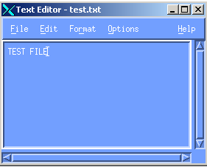
Now you’re logged on: Using xedit
32
There are a number of text editors available in UNIX, xedit is one of the easiest and straight forward text editors to use so is suggested to be used at PAREXEL.
To use xedit, type xedit at the UNIX command prompt
To open a file (test.txt) using xedit, type xedit test.txt at the command prompt
xedit is essentially the UNIX equivalent of a windows text editor similar to notepad
It should be used for viewing log files and text files.
It is recommended not to update SAS code using xedit but to use sas (SAS 9.1), sas91 (SAS 9.1) or sas92 (SAS 9.2) program editor
Notes:
32
Demo: Opening file, demo some menus, commands, such as find/ find and replace

Slide 33
Now you’re logged on: SAS in UNIX
33
To start SAS in UNIX, use the command sas (this will start SAS version 9.1), to explicity start SAS 9.2, type sas92 at the unix prompt.
Note: typing sas91 will also start SAS version 9.1
A version of SAS should consistently be used across the project and should be discussed with the DOL.
To start SAS in background mode, so that you can continue using the UNIX session as well as SAS, use the command sas &
To run a SAS program (export.sas) in batch mode (the program is run without visually opening SAS), use the command sas export.sas or sas export
To run a SAS program (export.sas) in interactive mode, SAS should be started and the program submitted from within.
If you run any programs in batch mode, you can see which programs are running, by using the jobs command
For example, if you run export.sas in batch mode (sas export.sas &), you can see this, by typing jobs. The UNIX session will show Running sas export.sas &
Notes:
33

Slide 34
Now you’re logged on: Transferring files 1
34
Multiple systems used at PAREXEL are:
winSCP recommended system
Samba
sftp – (transfers between unix systems, e.g. kennet)
Samba is software that is run on UNIX and allows UNIX and Windows to communicate as if UNIX, hence allowing you to view files in Windows which are being hosted on UNIX.
If you use Samba to transfer files, be aware that Samba may transfer a file in the wrong format adding newline characters into a file, if this occurs then a further command should be performed in UNIX to correct the file format.
To convert a file (testwin.txt) to a UNIX formatted file (testUNIX.txt), the command dos2ux testwin.txt > testUNIX.txt should be used.
Notes:
34
Demostrate
In test dir
$ dos2ux Book1.csv > BookUNIX.csv

Slide 35
Now you’re logged on: Transferring files 2
35
WinSCP is a free SFTP (Secure Shell File Transfer Protocol) and SCP (Secure Copy Protocol) client for windows. It’s main function is to allow safe copying of files between a local and remote computer (e.g. the transfer of files from your local machine to a UNIX directory)
To use WinSCP, you can start this from Start – All Programs – WinSCP
You can set up an instance, by clicking the New button
You then need to specify the instance (e.g. kennet), username (e.g. cantrea) and password
You can change transfer options, by using Options – Preferences – for example ensuring that WinSCP transfers SAS files in ascii format
http://winscp.net/eng/docs/guides
Notes:
35
Demostrate how to use winSCP show the user about how to copy files.

Slide 36
Now you’re logged on: Some other commands 1
36
By using the up and down arrows at the prompt you can recall previous / recent commands executed at the prompt.
The tab key can be used to autocomplete text you are typing, for example, if you want to edit a file areallyreallylongfilename.txt using xedit, the command
xedit areally followed by the user pressing the tab key would result in
xedit areallyreallylongfilename.txt being displayed which will save the user time in typing filenames in.
Note: the autocomplete option will only autocomplete as much as possible for uniqueness of file names.
e.g. if you have files test1.txt and test2.txt, then typing te followed by the tab key will result in test being displayed, as the next character could either be a 1 or a 2 so can not be autocompleted.
If you press tab twice, UNIX will list all the filenames that can be autocompleted
Notes:
36
Demonstrate
Create a file areallylongfilename.txt
For autocomplete go into test1 dir
$ xedit te – press enter it will give only test and not the complete name of the file. So the auotcomplete option will only auotcomplete as much as possible for uniqueness of the file names.

Slide 37
Now you’re logged on: Some other commands 2
37
The clear command will clear the UNIX window with the prompt appearing at the top of the screen.
The middle mouse button can be pressed to paste text held within the paste buffer into UNIX – so could copy a word text file straight to UNIX
By hovering the mouse pointer over the scroll bar, pressing the middle mouse button and moving the mouse up and down, you can scroll up and down in the UNIX window.
Notes:
37
Demo copying and pasting between Unix and Windows using the Exceed toolbar

Slide 38
Further information
Part Three: Additional Information
38
38

Slide 39
Additional Information: Process Control 1
The ps command can be used to display the list of current processes being run by the user
When ps is used without any options, it displays four items of information for the processes currently on the system
ps itself is a process and it is terminated as soon as its output is displayed.
The four items are labelled PID, TTY, TIME and CMD.
TIME is the amount of CPU time in minutes and seconds that the process has been running, CMD is the name of the command that launched the process, TTY is the name of the console or terminal that the user logged into, which can also be found by using the tty command. PID is the process ID on the system.
39
Notes:
39

Slide 40
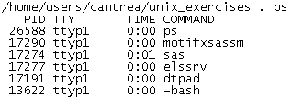
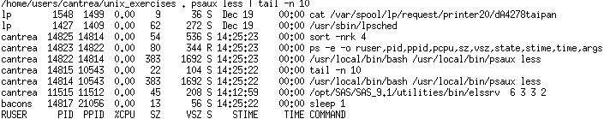
Additional Information: Process Control 2
The command psaux may be used to display more complete and complex information on the processes currently running on the system
40
Notes:
40

Slide 41
Additional Information: Process Control 3
Processes can either be run in the foreground (default) or the background.
To run a process (sas) in background mode, type sas & at the command prompt.
If a process is not run in background mode, then the UNIX prompt can not be accessed until the process is closed or completed.
In some instances, processes may become out of control and can not be accessed (such as a SAS session).
The kill command is used terminate a process, to terminate a process (17274), use kill 17274
Use kill -9 17274 to force the process to be killed - should be used if the command above does not result in the process being stopped
You can only kill your own processes (e.g. processes that your account is running)
41
Notes:
41
17274 is an example process ID
For getting the process ID for a process/program which is currently being run
$ ps –ef | grep sas export_v1.sas
Or
$ ps –ef | grep export – We get a process ID for this task
Using which we can kill the process
Kill -9 <process ID> will force the process to be killed

Slide 42
Additional Information: Disk usage
42
As a user of UNIX, you need to be aware of your impact on the system both from a disk usage and disk space aspect.
The du command displays the number of 512-byte blocks used by all files and directories
The command du –xsk * | sort –n will display the total file space (in 1024-byte blocks) used by each file listed in increasing disk usage order (if a directory contains multiple files, only the total directory size will be listed)
The bdf command displays disk space information, including disk space used, disk space remaining for all file systems present.
To see the space used on the disk you are currently on, use the bdf . command.
Notes:
42
Clear the unix window before you demostrate.

Slide 43
Additional Information: zip / unzip
43
The zip command creates a compressed file containing specified files, this can reduce the amount of disk space used by project files.
To create a zip file (test.zip) containing files a.txt and b.txt use
zip test.zip a.txt b.txt
By also removing nonessential files and compressing large files, disk space can be used sensibly.
The unzip command uncompresses a zip file.
To unzip a zip file (test.zip) containing files a.txt and b.txt use
unzip test.zip a.txt b.txt
The zip functionally can be used to allow easier transfer of files to another file system, e.g. it is easier to move a 1MB file to Windows rather than an unzipped 500MB file.
Similarly SAS datasets should ideally be stored in SAS transfer files for a similar file compression.
Notes:
43
Demostrate
Create a zip file for the file a in test directory
$ zip a b c
Create a zip file for the sas files in the home dir

Slide 44
Additional Information: Logging off
44
To exit the UNIX session cleanly, type exit at the command prompt.
Note: Ctrl+D can be used on the UNIX screen – should ensure that you have closed all applications before doing this or you may lose work
Then use the Start button – Log off option to log off from the Citrix desktop session.
It is good practice to do this to ensure that no stray UNIX sessions or processes are left running (which leads to system slowdown).
Notes:
44
Exit
Ctrl+D – save your work before using this command

Slide 45
Thank you
45

